Slide 1
From Headlines to Alerts:
Predicting Weekly Compliance Volumes
“The A-Team”

Slide 2
Baseline Model

Slide 3
EDA and Preliminary Modeling
The first attempts to scrape articles and parse them according to keywords were hindered by the web scraper favoring more recent articles, resulting in a very low overlap between the weeks in the articles and alerts dataframes.
Once this was fixed, a second problem became evident-the number of articles being returned necessitated batch processing of the data, followed by concatenation of the batches.
Poisson regression was run on the data, but the great difference between the mean and variance showed the necessity of trying negative binomial regression.

Slide 4
NB, Gradient Boosting Model
Because of the collinearity of many of the features, training was severely overfitting.
VIF measures were taken to reduce collinearity, with minimal improvement.
Gradient boosting (raw, log-transformed, and square-root transformation) were run to compare against the NB model.
MAE and RMSE were not improving with these trials
It became clear that the extreme variance in alert volumes was making it difficult for the model to perform well on the testing set.
Therefore, the nature of the target variable had to be transformed from raw counts

Slide 5
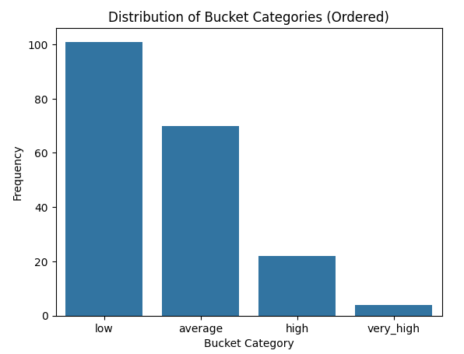
Purpose & Features
The team aimed to establish a minimum benchmark for the subsequent, more complex models to beat.
The target variable, or the number of alerts, was log-transformed and discretized into four buckets: ‘low’, ‘average’, ‘high’ and ‘very high’ and encoded–0, 1, 2, and 3.
These multinomial category targets were used both in the baseline model and in subsequent models of our experiment.

Slide 6
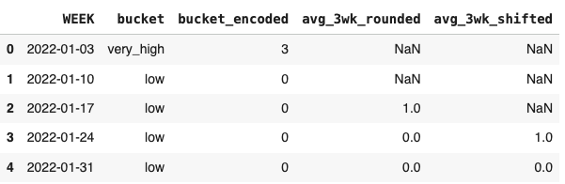
Methodology
The baseline model used a 3-week rolling average of the target buckets, rounded to the nearest integer.
The 3-week rolling average was shifted to the subsequent 4th-week.

Slide 7
Methodology & Performance
We then created a binary variable representing whether the 4th-week’s bucket was equal to that of the 3-week rolling average.
The binary variable was averaged across all weeks with available data.
This served as the foundational accuracy we sought to beat with our model.
Model: | Accuracy:
Baseline | 60.82%

Slide 8
Logistic Regression Model
Notes:
After discretizing the target variable, the team pivoted to utilizing a multi-class logistic regression model. Next slide.

Slide 9
Feature Engineering - Keywords
Several parallel model development pipelines were explored early on in the process.
Using titles and the TfidfVectorizer was one such model that was improved upon throughout development. First, applying the TfidfVectorizer to Article Text, and then finally to Keywords extracted from Articles.
To predict the current week’s alert bucket, we use keyword information from the three previous weeks, creating new feature columns for each lagged week, approximately 15,000 features.
Notes:
The team initially explored using ‘titles’ as the predictive features, and later pivoted to the article’s keywords.
All logistic regression models utilized Term-Frequency Inverse-Document Frequency, which is a method used in natural language processing that transforms text into numerical vectors by prioritizing words that have a high frequency in a single document but are rare against the entire collection of documents.
To account for the target variable’s temporal nature, we then lagged the features. Thus, the predictive features for a single week were the top keywords for the previous three weeks. Next slide.

Slide 10
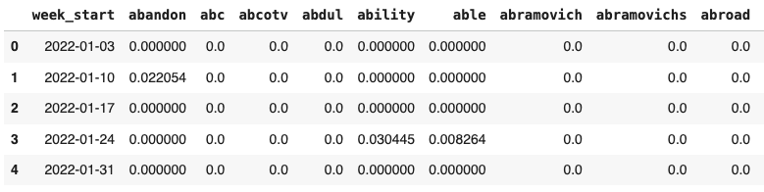
Feature Engineering - Keywords
Notes:
This picture shows what the feature matrix looks like. Next slide.

Slide 11
Data Splitting
To adhere to the chronological order of the data, a chronological 80% Train / 20% Test split was used.
Metric | Rows | Columns
X_train | 157 | 15,000
y_train | 157 | 1
X_test | 40 | 15,000
y_test | 40 | 1
Notes:
The first 157 weeks, were used for the training data, while the last 20% of the data (~ 40 weeks) was used for testing. Next slide.

Slide 12
Model Improvement Strategy #1: Class Balancing
Problem:
The alert counts are not uniformly distributed across the four buckets.
The ‘low’ bucket dominates, while the ‘very_high’ bucket is rare.
Effect:
A standard classifier will naturally achieve high accuracy by predicting the majority class most of the time.
Poor performance on the minority class.
Poor generalization if the underlying data distribution changes.
The class_weight=’balanced’ Solution:
Weights are inversely proportional to the class frequencies in the input data.
Increases penalty for misclassifying a minority class instance.
Decreases penalty for misclassifying a majority class instance.
Notes:
One thing we noticed was our target variable classes were imbalanced within the training set, so naturally the model will predict the majority class well but have poor performance on the minority class. Thus, by setting the class balancing flag within the logistic regression pipeline, we forced to model to increase the penalty for misclassifying a minority class instance. Next slide.
1. Addressing Skewed Data Distribution
The Problem: The alert counts are not uniformly distributed across the four buckets ('low', 'average', 'high', 'very_high'). It is highly likely that the 'low' bucket is predominant, while the 'very_high' bucket is rare (a minority class).
The Effect: A standard classifier trained on this skewed data will naturally achieve high accuracy by simply predicting the majority class ('low') most of the time. However, this model will be useless for the minority classes (the alerts we actually care about forecasting), as its ability to distinguish between 'high' and 'very_high' will be poor.
2. The class_weight = ‘balanced’ Solution
The class_weight = ‘balanced’ parameter automatically computes weights inversely proportional to the class frequencies in the input data:
The Benefit: During training, this technique:
Increases the penalty for misclassifying a minority class instance ('very_high').
Decreases the penalty for misclassifying a majority class instance ('low').
This forces the model to pay more attention to the rare, but important, classes, making the overall decision boundary more robust and improving performance on the minority groups.
3. Evaluating with the F1-Weighted Score
The choice of F1-Weighted Score as the primary evaluation metric is directly linked to class balancing.
Unlike simple Accuracy, the F1-Weighted Score takes into account the proportion of each class, providing a more reliable measure of performance when class imbalance is present.
The goal of class balancing is to maximize this metric, ensuring that the final model is a practical and effective predictor for all alert levels, not just the most common one.

Slide 13
Log Reg Model #1:
Model:
Basic multi-class logistic regression model on non-lemmatized TF-IDF features.
Performance:
Insight:
The model appears to be overfit, as illustrated by the marked decrease in all metrics between the training and testing set.
It is also possible the training set and testing set have time series drift or some other mechanism at play, but we assumed overfitting for improvement.
Metric | Training Set | Testing Set
F1-Weighted Score | 86.5% | 15.9%
F1-Macro Score | 56.3% | 9.1%
Accuracy | 88.5% | 15.0%
Notes:
Here’s an overview of our first logistic regression model, or what we considered to be the baseline logistic regression model. The model had high performance on the training set, but had markedly different performance on the testing set, suggesting that the model might be overfitting to the data. There is the possibility of other influential factors; however, we isolated our optimization strategies to first target overfitting. Next slide.

Slide 14
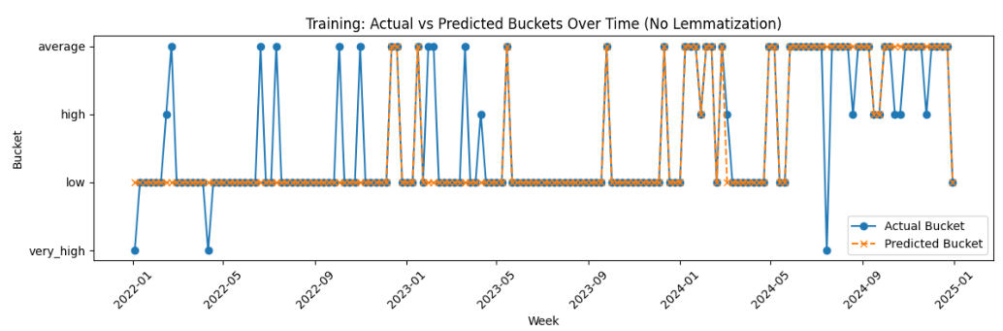
Log Reg Model #1: Training
Notes:
This plots the model’s predictions (in orange) vs. the actual predictions (in blue). Next slide.

Slide 15
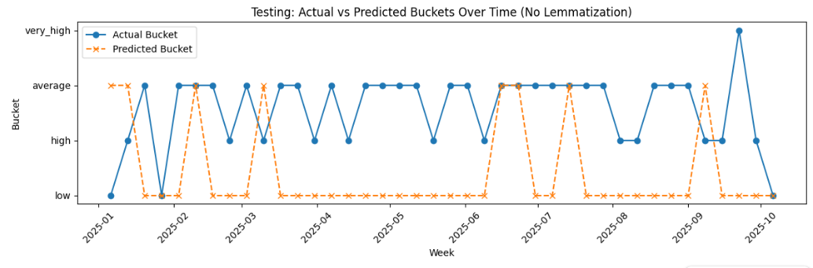
Log Reg Model #1: Testing
Notes:
Conversely, you can see that the model performed extremely poorly on the testing data. Next slide.

Slide 16
Model Improvement Strategy #2: Lemmatization
Problem:
In text data, the same core word can appear in many different forms (running, ran, runs).
Treated as a separate, distinct feature in TF-IDF.
Effect:
Inflates the overall vocabulary size.
Increased model complexity.
Prone to overfitting.
Lemmatization Solution:
Lemmatization reduces a word to its base form (running, ran, runs → run).
Reduces feature dimensionality
Increases feature density, making the feature more representative.
Notes:
One problem associated with using TF-IDF vectorization is that the same core word can appear in many different forms (running, ran, runs), which are treated as separate, distinct features. This essentially inflates the overall vocabulary size and can cause overfitting.
Lemmatization is a technique which reduces a word to its base form (running, ran, runs all become run). This reduces the feature dimensionality and also allows the chosen features to become more representative of the article’s context. Thus, in the second model, we applied lemmatization prior to the TF-IDF vectorization, changing the keywords and associated vectors, resulting in improved performance metrics on the testing data. Next slide.
The Problem: In text data, the same core concept can appear in many different inflected forms (e.g., "running," "ran," "runs"). Without processing, the TfidfVectorizer treats each of these as a separate, distinct feature.
The Effect: This leads to a highly sparse feature matrix (many columns with mostly zero values) and inflates the overall vocabulary size. A larger vocabulary makes the model more complex and prone to overfitting.
The Lemmatization Solution: Lemmatization reduces a word to its base or dictionary form, known as its lemma (e.g., "running," "ran," and "runs" all become "run"). By grouping these variations, we:
Reduce Feature Dimensionality: The model learns a relationship for the single lemma "run" instead of three separate word forms.
Increase Feature Density: The TF-IDF score for "run" is based on all its variations, making the feature more representative and robust.

Slide 17
Model Improvement Strategy #3: Regularization
Problem:
TF-IDF vectorization resulted in a high-dimensional feature space (15,000 features) with 157 observations.
Potential for the model to assign extremely large weights to specific, non-generalizable keywords.
Effect:
Model can perfectly fit the noise, leading to overfitting and poor testing performance.
Tuned Regularization Solution:
Tune the ‘C’ parameter with a GridSearchCV with TimeSeriesSplit.
Large C: Less penalty, higher risk of overfitting.
Small C: Heavy penalty, higher risk of underfitting.
Optimization Goal: Achieve the best possible F1-Weighted score.
Notes:
In model #3, we wanted to tackle some of what we perceived as overfitting by optimizing the regularization parameter, where a larger C parameter penalizes misclassifications less and a smaller C parameter assigns higher penalties to misclassification. Due to the class-imbalance, the optimal parameter was selected based upon achieving the best possible F1-weighted score. Next slide.
L2 regularization - Ridge
1. Combating Overfitting in High-Dimensional Data
The Problem: The TF-IDF vectorization resulted in a high-dimensional feature space (up to 5000 features per lag, totaling up to 15,000 features). When the number of features approaches or exceeds the number of samples, a model like Logistic Regression can assign extremely large weights to specific, non-generalizable keywords.
The Effect: This allows the model to perfectly fit the noise and idiosyncrasies of the training data, leading to the high training score (Accuracy: 88.54%) and disastrous test score (Accuracy: 15.00%).
The Regularization Solution: L2 Regularization adds a penalty term to the model's loss function, proportional to the square of the magnitude of the coefficients.
This forces the model to choose smaller, more conservative weights.
By shrinking the weights, the model becomes less sensitive to any single keyword, promoting a smoother decision boundary and improving its ability to generalize to unseen test data.
2. Tuning the Complexity with the C Parameter
In scikit-learn’s Logistic Regression, the regularization strength is controlled by the parameter C, which is the inverse of the regularization strength.
Large C: Less penalty, more complex model, higher risk of overfitting.
Small C: Heavy penalty, simpler model, higher risk of underfitting.
GridSearchCV with TimeSeriesSplit was crucial here:
We used this process to systematically search for the optimal value of Cthat achieves the best possible F1-Weighted score on the validation sets, ensuring the optimal balance between bias (underfitting) and variance (overfitting).

Slide 18
Model Improvement Strategy #4: Dimensionality Reduction
Problem:
15,000 features >> 157 training observations
Effect:
Extreme overfitting & increased computational cost.
Principal Component Analysis (PCA) Mechanism Solution:
PCA linearly transforms the features into a new set of dimensions.
Works by finding the components that capture the maximum variance in the original data.
Tune the number of components using GridSearchCV, maximizing the F1-weighted score.
Removes noise
Regularizes the model
Notes:
Finally, dimensionality reduction, implemented via Principal Component Analysis (PCA), was a critical strategy to improve model stability and performance within our high-dimensional feature space, which was causing significant overfitting of the model. PCA identifies the components that capture maximum variance in the original data and then uses those features as predictors, helping to remove the noise.
We implemented the same tuning strategy; however, in model #4 we tuned both the regularization parameter and the number of components in tandem, giving the final iteration of the model and the best performance. Next slide.
1. The Need for Reduction
High Feature Count: The process of creating TF-IDF features and then lagging them (up to 3 weeks) resulted in a feature matrix with thousands of columns (up to 15,000 features).
The Consequences:
Overfitting Risk: A model with too many features can easily memorize the training data, leading to the massive train/test performance gap observed previously.
Computational Cost: Training the model becomes slower and more resource-intensive.
Multicollinearity: Many TF-IDF features are likely highly correlated, which can destabilize the Logistic Regression coefficient estimates.
2. The PCA Mechanism
PCA is an unsupervised technique used to linearly transform the features into a new set of dimensions called Principal Components.
It works by finding the directions (components) that capture the maximum variance in the original data.
The first few components capture most of the meaningful information, while later components capture noise.
Pipeline Integration: PCA was inserted into the pcaRegPipeline after standard scaling (StandardScaler) to ensure all features contribute equally to the variance calculation.
3. Tuning pca_n_components
The key hyperparameter tuned using GridSearchCV was $\mathbf{pca\_\_n\_components}$, which determines the number of principal components to retain.
The Goal: To find the smallest number of components that still retains enough predictive power to maximize the F1-Weighted Score.
By tuning this parameter, we simultaneously:
Remove Noise: Discarding low-variance components that likely contain little predictive information.
Regularize the Model: Creating a much smaller, more stable set of input features for the final Logistic Regression classifier, which effectively works as a form of regularization.

Slide 19
Final Performance Evaluations

Slide 20
Final Model Performance Comparison: Accuracy
Accuracy
Model | Training Set | Testing Set
Baseline | 60.8%
Log Reg Model #1 | 88.5% | 15.0%
Log Reg Model #2 | 87.9% | 22.5%
Log Reg Model #3 | 100% | 50.0%
Log Reg Model #4 | 49.7% | 55.0%

Slide 21
Final Model Performance Comparison: F1-Weighted
F1-Weighted
Model | Training Set | Testing Set
Log Reg Model #1 | 86.5% | 15.9%
Log Reg Model #2 | 85.4% | 24.9%
Log Reg Model #3 | 100% | 40.7%
Log Reg Model #4 | 55.2% | 46.7%

Slide 22
Final Model Performance Comparison: F1-Macro
F1-Macro
Model | Training Set | Testing Set
Log Reg Model #1 | 56.3% | 9.1%
Log Reg Model #2 | 52.9% | 13.1%
Log Reg Model #3 | 100% | 17%
Log Reg Model #4 | 38.8% | 21%

Slide 23
Challenge: Data Drift

Slide 24
Data Drift
Data Drift:
Occurs when the statistical properties of the incoming data (i.e., the keywords and their meanings) change over time.
Potential Causes:
Keywords that were predictive in the past may lose relevance in the present
Due to political and geopolitical changes,
The underlying distribution of the target variable can change over time.
Impact:
Degrading performance on testing data over time.

Slide 25
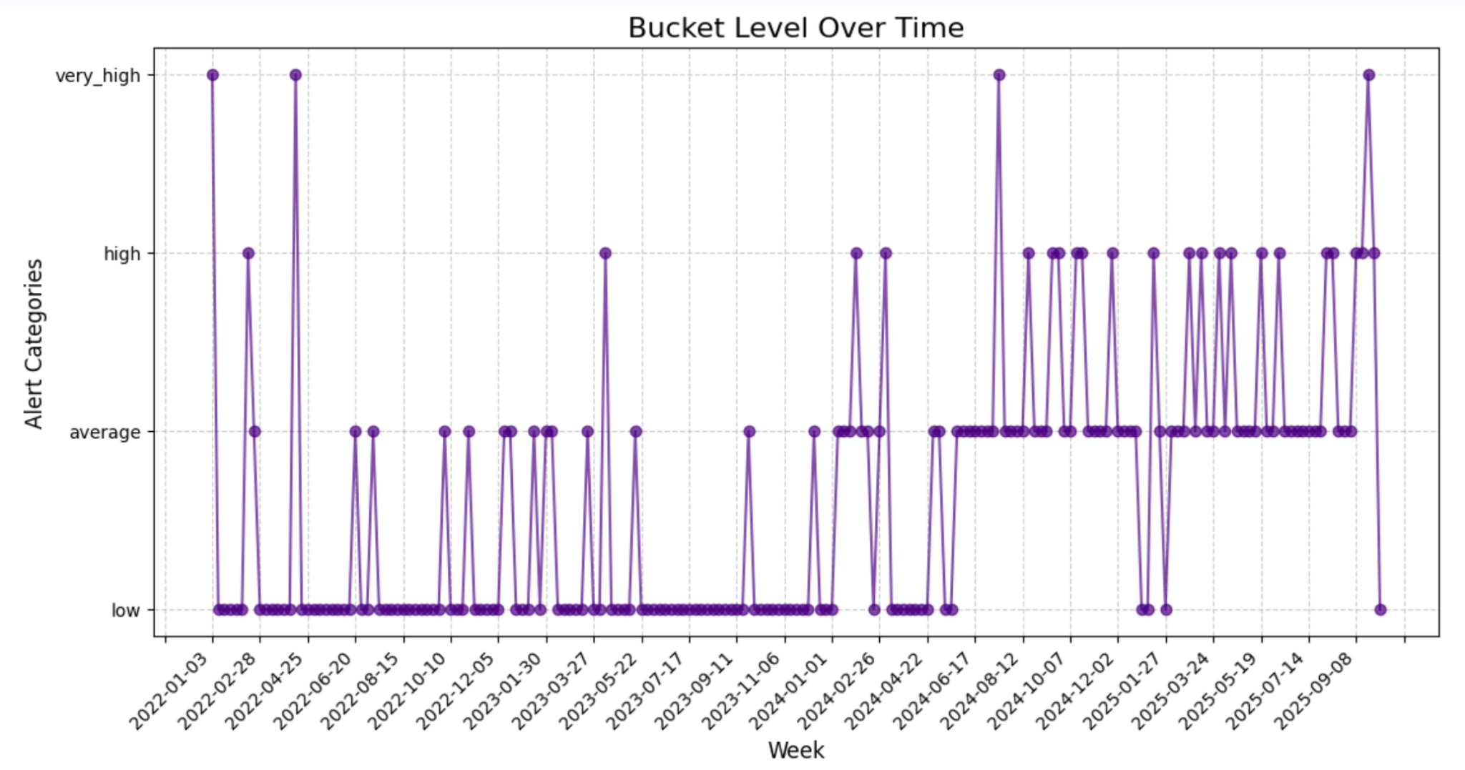
Data Drift Visualization

Slide 26
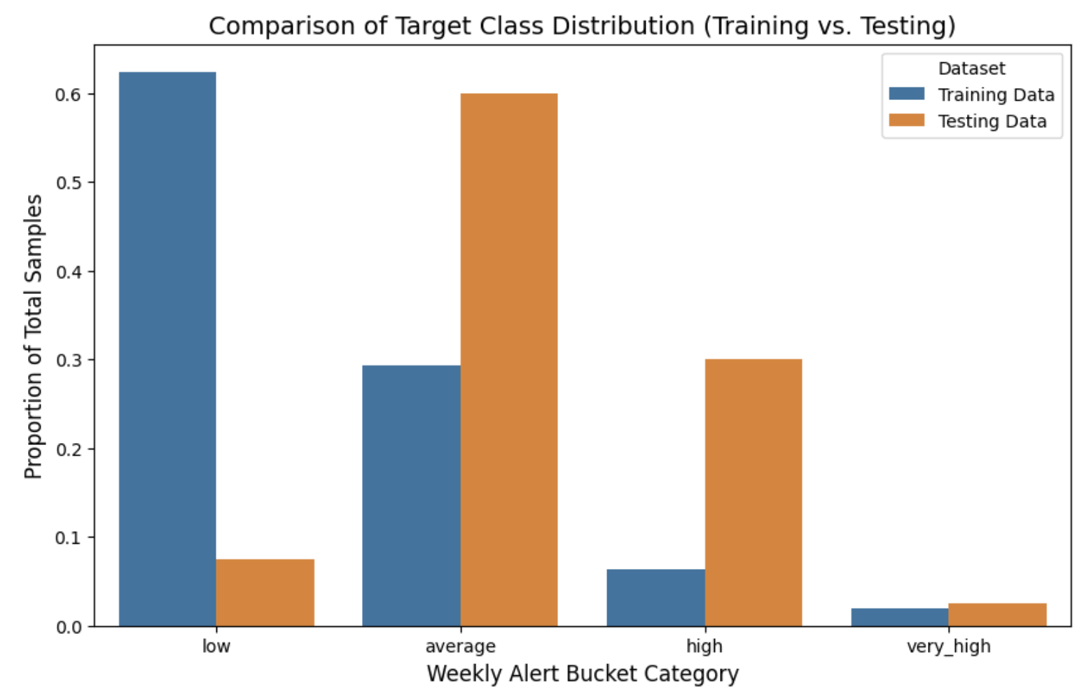
Data Drift Visualization

Slide 27
Conclusion & Next Steps

Slide 28
Project Summary
The project successfully developed a time-series classification framework using lagged TF-IDF features from article keywords to forecast weekly alert buckets.
Initial models suffered from apparent overfitting, demonstrating the need for robust tuning.
The integrated strategy of regularization (L2), class balancing, and dimensionality reduction (PCA), combined with the time-series-aware TimeSeries Split, was critical for building a generalizable model.
Further experimentation is necessary to determine the viability of this model for deployment. Currently, the model does not outperform the baseline model.
With the integration of more robust time series handling and other tools for generalization, it is possible the model can be improved as it has been improved considerably with modest adjustments already.
Notes:
Dimensionality reduction, implemented via Principal Component Analysis (PCA), was a critical strategy to improve model stability and performance within our high-dimensional feature space.
1. The Need for Reduction
High Feature Count: The process of creating TF-IDF features and then lagging them (up to 3 weeks) resulted in a feature matrix with thousands of columns (up to 15,000 features).
The Consequences:
Overfitting Risk: A model with too many features can easily memorize the training data, leading to the massive train/test performance gap observed previously.
Computational Cost: Training the model becomes slower and more resource-intensive.
Multicollinearity: Many TF-IDF features are likely highly correlated, which can destabilize the Logistic Regression coefficient estimates.
2. The PCA Mechanism
PCA is an unsupervised technique used to linearly transform the features into a new set of dimensions called Principal Components.
It works by finding the directions (components) that capture the maximum variance in the original data.
The first few components capture most of the meaningful information, while later components capture noise.
Pipeline Integration: PCA was inserted into the pcaRegPipeline after standard scaling (StandardScaler) to ensure all features contribute equally to the variance calculation.
3. Tuning pca_n_components
The key hyperparameter tuned using GridSearchCV was $\mathbf{pca\_\_n\_components}$, which determines the number of principal components to retain.
The Goal: To find the smallest number of components that still retains enough predictive power to maximize the F1-Weighted Score.
By tuning this parameter, we simultaneously:
Remove Noise: Discarding low-variance components that likely contain little predictive information.
Regularize the Model: Creating a much smaller, more stable set of input features for the final Logistic Regression classifier, which effectively works as a form of regularization.

Slide 29
Primary Challenges
Extreme Overfitting:
The high dimensionality caused initial models to memorize the training data.
Consequence: Massive drop in performance on the test set.
Class Imbalance:
Skewed target variable (‘bucket’)
Mitigation required the use of class_weight = ‘balanced’
Primary optimization metric: F1-Weighted Score
Data Drift:
Underlying distribution of the target variable changed between the testing and training sets, causing the model’s performance to suffer.
Notes:
Dimensionality reduction, implemented via Principal Component Analysis (PCA), was a critical strategy to improve model stability and performance within our high-dimensional feature space.
1. The Need for Reduction
High Feature Count: The process of creating TF-IDF features and then lagging them (up to 3 weeks) resulted in a feature matrix with thousands of columns (up to 15,000 features).
The Consequences:
Overfitting Risk: A model with too many features can easily memorize the training data, leading to the massive train/test performance gap observed previously.
Computational Cost: Training the model becomes slower and more resource-intensive.
Multicollinearity: Many TF-IDF features are likely highly correlated, which can destabilize the Logistic Regression coefficient estimates.
2. The PCA Mechanism
PCA is an unsupervised technique used to linearly transform the features into a new set of dimensions called Principal Components.
It works by finding the directions (components) that capture the maximum variance in the original data.
The first few components capture most of the meaningful information, while later components capture noise.
Pipeline Integration: PCA was inserted into the pcaRegPipeline after standard scaling (StandardScaler) to ensure all features contribute equally to the variance calculation.
3. Tuning pca_n_components
The key hyperparameter tuned using GridSearchCV was $\mathbf{pca\_\_n\_components}$, which determines the number of principal components to retain.
The Goal: To find the smallest number of components that still retains enough predictive power to maximize the F1-Weighted Score.
By tuning this parameter, we simultaneously:
Remove Noise: Discarding low-variance components that likely contain little predictive information.
Regularize the Model: Creating a much smaller, more stable set of input features for the final Logistic Regression classifier, which effectively works as a form of regularization.

Slide 30
Lessons Learned
"I have not failed. I've just found 10,000 ways that won't work." -Thomas Edison
The project stemmed from a small initial pet-project attempt using ARIMAX in R.
Some initial coding toward a linear solution with regularization scheme comparison was done (see: https://colab.research.google.com/drive/11P0VQtthbUbj81D4VDDso9STlIsk8lN0?usp=sharing)
The team then shifted toward a more purely count prediction-driven model. Poisson was discarded and negative binomial was chosen instead as the data is grossly overdispersed.
A pragmatic decision to move to bucketing was made so as to facilitate managerial hiring decisions: “is the prediction meaningful for decisions?” Logistic regression was the logical choice for such a categorical prediction.
Notes:
Dimensionality reduction, implemented via Principal Component Analysis (PCA), was a critical strategy to improve model stability and performance within our high-dimensional feature space.
1. The Need for Reduction
High Feature Count: The process of creating TF-IDF features and then lagging them (up to 3 weeks) resulted in a feature matrix with thousands of columns (up to 15,000 features).
The Consequences:
Overfitting Risk: A model with too many features can easily memorize the training data, leading to the massive train/test performance gap observed previously.
Computational Cost: Training the model becomes slower and more resource-intensive.
Multicollinearity: Many TF-IDF features are likely highly correlated, which can destabilize the Logistic Regression coefficient estimates.
2. The PCA Mechanism
PCA is an unsupervised technique used to linearly transform the features into a new set of dimensions called Principal Components.
It works by finding the directions (components) that capture the maximum variance in the original data.
The first few components capture most of the meaningful information, while later components capture noise.
Pipeline Integration: PCA was inserted into the pcaRegPipeline after standard scaling (StandardScaler) to ensure all features contribute equally to the variance calculation.
3. Tuning pca_n_components
The key hyperparameter tuned using GridSearchCV was $\mathbf{pca\_\_n\_components}$, which determines the number of principal components to retain.
The Goal: To find the smallest number of components that still retains enough predictive power to maximize the F1-Weighted Score.
By tuning this parameter, we simultaneously:
Remove Noise: Discarding low-variance components that likely contain little predictive information.
Regularize the Model: Creating a much smaller, more stable set of input features for the final Logistic Regression classifier, which effectively works as a form of regularization.

Slide 31
Next Steps
Implement Advanced Time-Series Modeling:
Investigate models designed specifically for sequences, such as Recurrent Neural Networks (RNNs), which may better capture complex temporal dependencies in the keyword data than Logistic Regression.
Model Retraining:
Implement a system for periodic model retraining to combat data drift, using only the most recent and relevant data for fitting.
Potential options include a rolling training window, training the model on a much more narrow window.
Feature Engineering Expansion:
Experiment with alternative features, such as integrating the previous week's actual alert bucket as a lagged feature.
Experiment with grouping the counts by shorter periods, increasing the number of observations and giving the model increased information.
Notes:
Dimensionality reduction, implemented via Principal Component Analysis (PCA), was a critical strategy to improve model stability and performance within our high-dimensional feature space.
1. The Need for Reduction
High Feature Count: The process of creating TF-IDF features and then lagging them (up to 3 weeks) resulted in a feature matrix with thousands of columns (up to 15,000 features).
The Consequences:
Overfitting Risk: A model with too many features can easily memorize the training data, leading to the massive train/test performance gap observed previously.
Computational Cost: Training the model becomes slower and more resource-intensive.
Multicollinearity: Many TF-IDF features are likely highly correlated, which can destabilize the Logistic Regression coefficient estimates.
2. The PCA Mechanism
PCA is an unsupervised technique used to linearly transform the features into a new set of dimensions called Principal Components.
It works by finding the directions (components) that capture the maximum variance in the original data.
The first few components capture most of the meaningful information, while later components capture noise.
Pipeline Integration: PCA was inserted into the pcaRegPipeline after standard scaling (StandardScaler) to ensure all features contribute equally to the variance calculation.
3. Tuning pca_n_components
The key hyperparameter tuned using GridSearchCV was $\mathbf{pca\_\_n\_components}$, which determines the number of principal components to retain.
The Goal: To find the smallest number of components that still retains enough predictive power to maximize the F1-Weighted Score.
By tuning this parameter, we simultaneously:
Remove Noise: Discarding low-variance components that likely contain little predictive information.
Regularize the Model: Creating a much smaller, more stable set of input features for the final Logistic Regression classifier, which effectively works as a form of regularization.

Slide 32
Team Contributions
Kristi Gibson:
Built the GDELT article scraping pipeline, generating an initial dataset of 56,000 URLs,
Constructed the initial multinomial logistic regression model with titles and implemented TF-IDF vectorization feature engineering
Comprehensively maintained all documentation throughout the project’s lifespan.
Brad Gordon:
Built and performed initial article scraping pipeline, using a Google search.
Constructed the initial modeling pipelines, which included Random Forest, Poisson, Negative Binomial, and Gradient Boosting Algorithms.
Cheyanne Allred-Lopez:
Refined the article scraping pipeline and conducted scraping on aggregated GDELT articles, performing error handling and data cleansing as needed to finalize the dataset.
Implemented lemmatization, principal component analysis, and hyperparameter tuning on the multinomial logistic regression pipeline.
Patrick Brooks:
Provided initial target variable counts and previous R code as a reference.
Notes:
Dimensionality reduction, implemented via Principal Component Analysis (PCA), was a critical strategy to improve model stability and performance within our high-dimensional feature space.
1. The Need for Reduction
High Feature Count: The process of creating TF-IDF features and then lagging them (up to 3 weeks) resulted in a feature matrix with thousands of columns (up to 15,000 features).
The Consequences:
Overfitting Risk: A model with too many features can easily memorize the training data, leading to the massive train/test performance gap observed previously.
Computational Cost: Training the model becomes slower and more resource-intensive.
Multicollinearity: Many TF-IDF features are likely highly correlated, which can destabilize the Logistic Regression coefficient estimates.
2. The PCA Mechanism
PCA is an unsupervised technique used to linearly transform the features into a new set of dimensions called Principal Components.
It works by finding the directions (components) that capture the maximum variance in the original data.
The first few components capture most of the meaningful information, while later components capture noise.
Pipeline Integration: PCA was inserted into the pcaRegPipeline after standard scaling (StandardScaler) to ensure all features contribute equally to the variance calculation.
3. Tuning pca_n_components
The key hyperparameter tuned using GridSearchCV was $\mathbf{pca\_\_n\_components}$, which determines the number of principal components to retain.
The Goal: To find the smallest number of components that still retains enough predictive power to maximize the F1-Weighted Score.
By tuning this parameter, we simultaneously:
Remove Noise: Discarding low-variance components that likely contain little predictive information.
Regularize the Model: Creating a much smaller, more stable set of input features for the final Logistic Regression classifier, which effectively works as a form of regularization.

Slide 33
Support

Slide 34
Log Reg Model #2: Lemmatization
Model:
Multi-class logistic regression model on lemmatized TF-IDF features. Default L2 regularization
Performance:
Insight:
The model still appears overfit, as illustrated by the marked decrease in all metrics between the training and testing set.
Metric | Training Set | Testing Set
F1-Weighted Score | 85.4% | 24.9%
F1-Macro Score | 52.9% | 13.1%
Accuracy | 87.9% | 22.5%
Notes:
Lemmatization helps ensure that the model correctly groups keywords that are semantically similar but syntactically different.
Custom Corrections: We implemented manual keyword_corrections (e.g., 'zelenskyys' -> 'zelensky') to standardize proper nouns that the automatic lemmatizer might miss, further ensuring consistency across the time series.
In a time-series forecasting problem, generalization is critical. The model must predict future alert counts based on unseen keywords.
By using lemmas, the model is less likely to overfit to the exact phrasing or inflection used in a specific training week. It focuses on the root concept of the keyword.
If a keyword like "negotiations" appears in the training set and "negotiating" appears in the test set, lemmatization ensures the model recognizes them as the same feature, leading to better generalization performance on unseen test data.

Slide 35
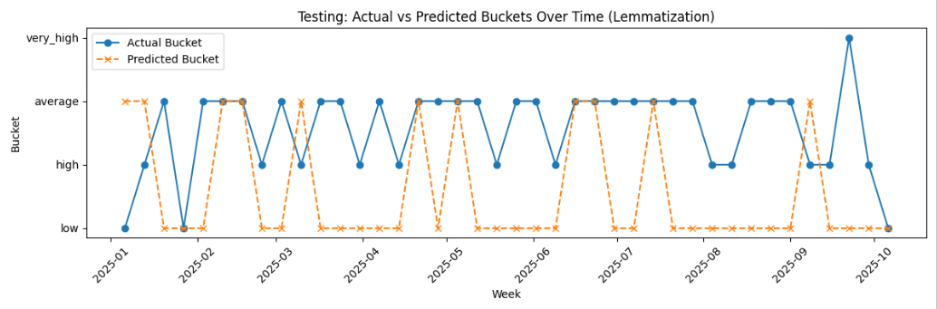
Log Reg Model #2: Testing
Notes:
Lemmatization helps ensure that the model correctly groups keywords that are semantically similar but syntactically different.
Custom Corrections: We implemented manual keyword_corrections (e.g., 'zelenskyys' -> 'zelensky') to standardize proper nouns that the automatic lemmatizer might miss, further ensuring consistency across the time series.
In a time-series forecasting problem, generalization is critical. The model must predict future alert counts based on unseen keywords.
By using lemmas, the model is less likely to overfit to the exact phrasing or inflection used in a specific training week. It focuses on the root concept of the keyword.
If a keyword like "negotiations" appears in the training set and "negotiating" appears in the test set, lemmatization ensures the model recognizes them as the same feature, leading to better generalization performance on unseen test data.

Slide 36
Model Performance (So Far)
F1-Weighted
Model | Training Set | Testing Set
Log Reg Model #1 | 86.5% | 15.9%
Log Reg Model #2 | 85.4% | 24.9%
Accuracy
Baseline | 60.8% Overall Fit
Log Reg Model #1 | 88.5% | 15.0%
Log Reg Model #2 | 87.9% | 22.5%
Notes:
Lemmatization helps ensure that the model correctly groups keywords that are semantically similar but syntactically different.
Custom Corrections: We implemented manual keyword_corrections (e.g., 'zelenskyys' -> 'zelensky') to standardize proper nouns that the automatic lemmatizer might miss, further ensuring consistency across the time series.
In a time-series forecasting problem, generalization is critical. The model must predict future alert counts based on unseen keywords.
By using lemmas, the model is less likely to overfit to the exact phrasing or inflection used in a specific training week. It focuses on the root concept of the keyword.
If a keyword like "negotiations" appears in the training set and "negotiating" appears in the test set, lemmatization ensures the model recognizes them as the same feature, leading to better generalization performance on unseen test data.

Slide 37
Log Reg Model #3: Lemmatization + Regularization
Model Tuning:
Optimal Parameter: C = 10.0
Performance:
Insight:
The trained model demonstrates the worst level of overfitting; however, it demonstrates the highest level of performance on the testing set.
Metric | Training Set | Testing Set
F1-Weighted Score | 100% | 40.7%
F1-Macro Score | 100% | 17%
Accuracy | 100% | 50.0%

Slide 38
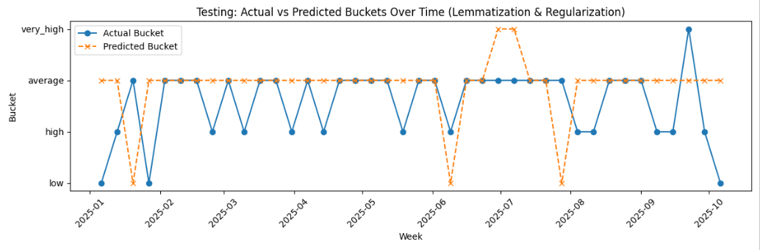
Log Reg Model #3: Testing

Slide 39
Model Performance
F1-Weighted
Model | Training Set | Testing Set
Log Reg Model #1 | 86.5% | 15.9%
Log Reg Model #2 | 85.4% | 24.9%
Log Reg Model #3 | 100% | 40.7%
Accuracy
Baseline | 60.8% Overall Fit
Log Reg Model #1 | 88.5% | 15.0%
Log Reg Model #2 | 87.9% | 22.5%
Log Reg Model #3 | 100% | 50.0%

Slide 40
Log Reg Model #4: Lemmatization, Regularization, PCA
Model Tuning:
Optimal parameter: C = 0.01, n_components = 5
Performance:
Insight:
The trained model demonstrates poor fit to the training set. PCA Dimensionality Reduction reduced the fit closeness but appears to have better generalized the model.
Metric | Training Set | Testing Set
F1-Weighted Score | 55.2% | 46.7%
F1-Macro Score | 38.8% | 21%
Accuracy | 49.7% | 55.0%

Slide 41
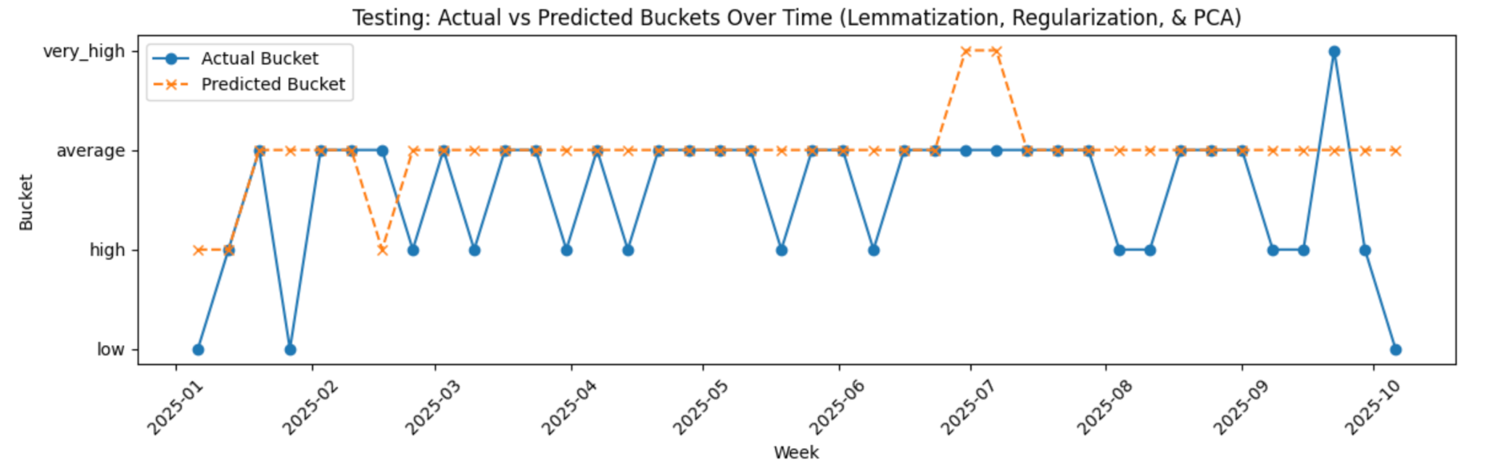
Log Reg Model #4: Testing

